Slide 1
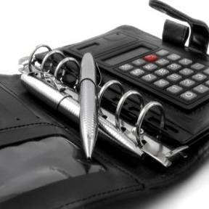
TYPICAL CALCULATION
Buy Back Plan
Unit Size : 2000 Sq Ft
Rate per Sq Ft : Rs.5500
Total Investment : Unit Size X Rate per Sq Ft
= 2000 X Rs5500 = Rs1,10,00,000
Buy Back after 2.5 years @ : 61.5%
Total Value in 2.5 years : Rs.1,77,65,000
Net Profit : Rs.67,65,000
Note: Min. Sq. Ft. Area for Buy Back Plan is 2000 Sq. Ft.

